Slide 1
Ray Tracing

Slide 2
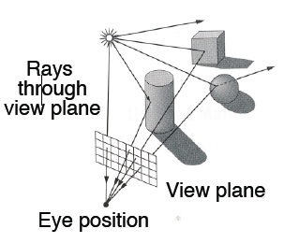
3D Rendering
The color of each pixel on the view plane
Depends on the radiance emanating from visible surfaces
Simplest method is ray tracing

Slide 3
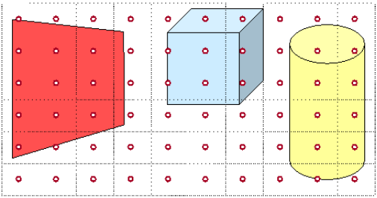
Ray Casting & Tracing
Independent lighting calculation for every pixel

Slide 4
Ray Casting & Tracing
For each sample
Construct ray from eye position through view plane
Find the first surface intersected by ray through pixel
Compute color sample based on surface radiance

Slide 5
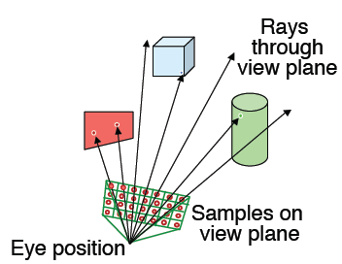
Ray Casting & Tracing
For each sample
Construct ray from eye position through view plane

Slide 6
Ray Casting
Just find the surface intersection point
Ray from eye to the screen pixel
No reflection or refraction
Direct illumination
Visible surface detection
Shadow calculation
Ray casting from the light source position

Slide 7
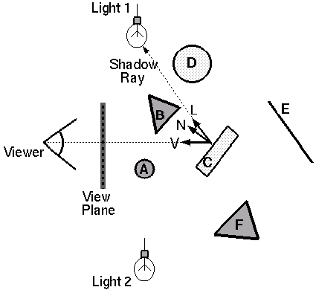
Ray Casting
Trace primary rays from camera
Direct illumination from unblocked lights only

Slide 8
Ray Tracing
Recursive ray casting
Inter-object light reflection effects
Global (mutual) illumination
For global reflection and transmission
Highly realistic quality vs. computation time
Process overview
Bounce (reflect) or refract the ray
Collecting its intensity
At each reflection/refraction point

Slide 9
Ray Tracing
Global illumination
Shadow
Transmission / refraction
Inter-object reflection
Highly realistic vs. computation time
Reflectance
Transparency
Shadow

Slide 10
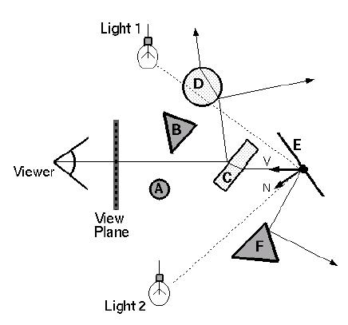
Basic Ray Tracing Algorithm
For each pixel ray
Primary ray
Test each surface if it is intersected
Intersected : secondary ray
Reflection ray
Transmission ray : transparent objects

Slide 11
Basic Ray Tracing Algorithm
For each pixel ray
Primary ray
Test each surface if it is intersected
Intersected : secondary ray
Reflection ray
Transmission ray : transparent objects

Slide 12
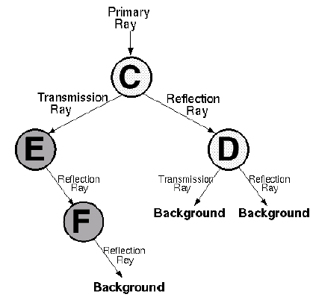
Ray Tracing Tree
Ray tracing tree represents illumination computation
One branch → reflection
The other branch → transmission
Terminated → reach the preset maximum or strike a light source
Scene
Ray Tree

Slide 13
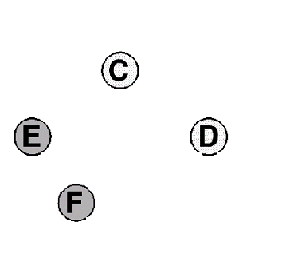
Ray Tracing Tree
Pixel intensity
Sum of intensities at root node
Start at terminal node
If no surfaces are intersected, the intensity of background
Scene
Ipixel
Ray Tree
Iback
Iback
Iback

Slide 14
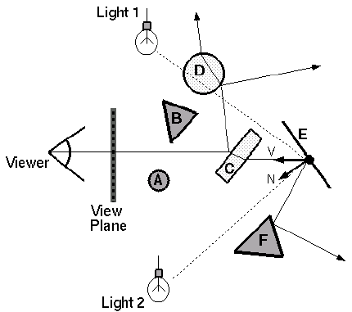
Transparency (1/2)
Trace secondary ray in direction of refraction
Radiance for
refraction ray

Slide 15
Transparency (2/2)
Transparency means the fraction transmitted
K_{T} = 1 if object is translucent
K_{T} = 0 if object is opaque
0 < K_{T} < 1 if object is semi-translucent
Transparency
Coefficient

Slide 16
Mirror Reflection
Trace secondary ray in direction of mirror reflection
Radiance
for mirror
reflection ray

Slide 17
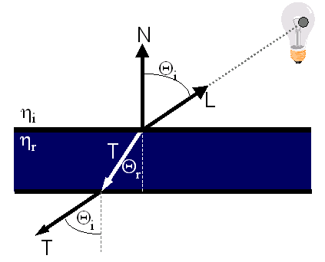
Refractive Transparency (1/2)
For thin surfaces, can ignore change in direction
Assume light travels straight through surface

Slide 18
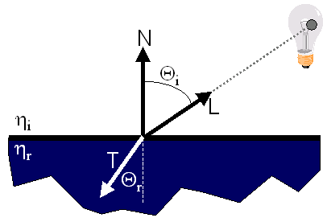
Refractive Transparency (2/2)
For solid objects, apply Snell’s law:
η_{r} sin Θ_{r} = η_{i} sin Θ_{i}

Slide 19
Implementation : Pseudocode
Image RayCast(Camera camera, Scene scene, int width, int height)
{
Image image = new Image(width, height);
for (int i = 0; i < width; i++) {
for (int j = 0; j < height; j++) {
Ray ray = ConstructRayThroughPixel(camera, i, j);
Intersection hit = FindIntersection(ray, scene);
image[i][j] = GetColor(hit);
}
}
return image;
}

Slide 20
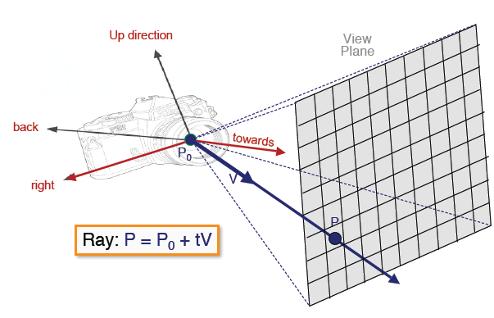
Implementation : Ray Construction
For each sample
Construct ray through a pixel

Slide 21
Implementation : Miscellaneous Issues
Intersections with geometric primitives
Sphere
Triangle
Groups of primitives (scene)
Acceleration techniques
Adaptive depth control
Bounding volume hierarchies
First-hit speedup
Spatial partitions
Uniform grids / octrees / BSP trees

Slide 22
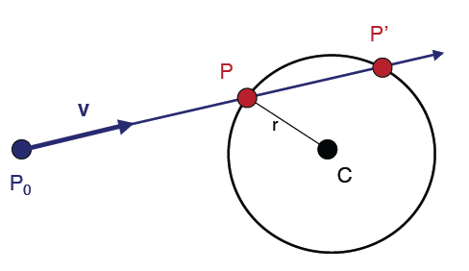
Implementation : Ray-Sphere Intersection (1/2)
Ray : P = P₀ + tV
Sphere : |P - C|² - r² = 0

Slide 23
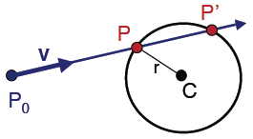
Implementation : Ray-Sphere Intersection (2/2)
Ray : P = P₀ + tV, sphere : |P - C|² - r² = 0
|P₀ + tV - C|² - r² = 0
Substituting for P
Solve quadratic equation
at² + bt + c = 0, where
a = |V|² = 1 // if ray direction is normalized
b = 2 V • (P0 - C)
c = |P₀ - C|² – r²
P = P₀ + tV

Slide 24
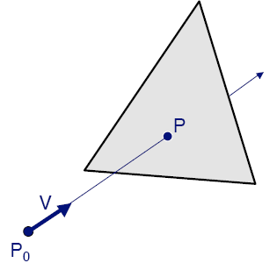
Implementation : Ray-Triangle Intersection
1. Intersect ray with plane
2. Check if point is inside triangle

Slide 25
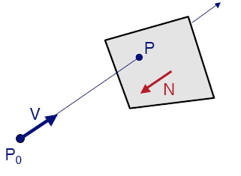
Implementation : Ray-Plane Intersection
Ray : P = P₀ + tV
Plane : P • N + d = 0
(P₀ + tV) • N + d = 0
Substituting for P
Solution
t = -(P₀ • N + d) / (V • N)
P = P₀ + tV

Slide 26
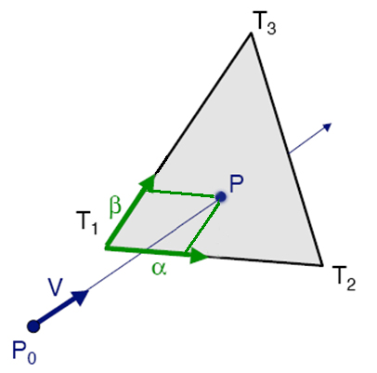
Implementation : Ray-Triangle Intersection Revisited
Check if point inside triangle parametrically
Compute α, β :
P = α (T₂-T₁) + β (T₃-T₁) + T₁
Check if point inside triangle
0 ≤ α ≤ 1 and 0 ≤ β ≤ 1
α + β ≤ 1

Slide 27
Implementation : Other Ray-Primitive Intersections
Cone, cylinder, ellipsoid
Similar to sphere
Box
Intersect 3 front-facing planes, return closest
Convex polygon
Same as triangle (check point-in-polygon algebraically)
Concave polygon
Same plane intersection
More complex point-in-polygon test

Slide 28
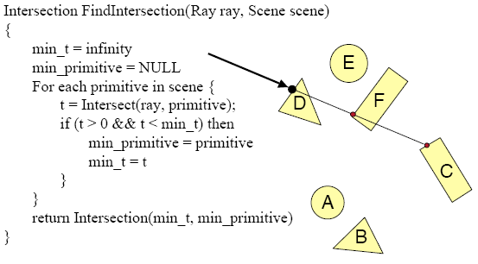
Implementation : Ray-Scene Intersection
Find intersection with the front-most primitive

Slide 29
Implementation : Adaptive Depth Control
Stop generating reflected/transmitted rays
When the computed intensity becomes less than a certain threshold
Always set a certain maximum depth
If not, infinite number of rays would be generated
Not always necessary to go to the maximum depth
If the surfaces are not highly reflective

Slide 30
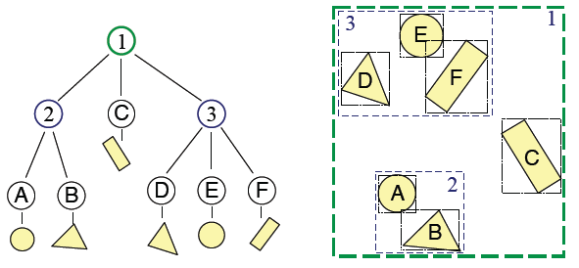
Implementation : Bounding Volume Hierarchies (1/3)
Build hierarchy of bounding volumes
Bounding volume of interior node contains all the children

Slide 31
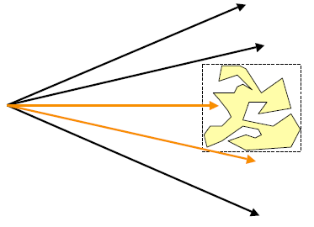
Implementation : Bounding Volume Hierarchies (2/3)
Bounding volumes
Check for intersection with simple shape first
If the ray doesn’t intersect bounding volume
Never intersect its contents
Still needs to check for intersections with the shape

Slide 32
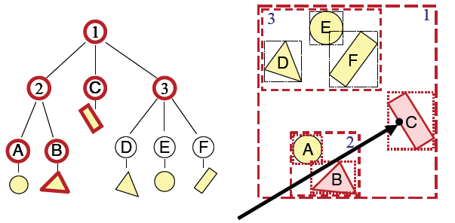
Implementation : Bounding Volume Hierarchies (3/3)
Use hierarchy to accelerate ray intersections
Intersection-test of node contents
Only if the bounding volume is hit

Slide 33
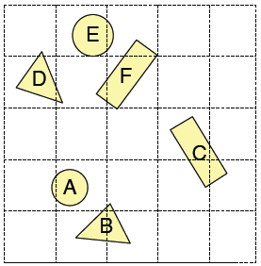
Implementation : Spatial Partitions (1/3)
Construct uniform grid over scene
Index primitives according to overlaps with grid cells

Slide 34
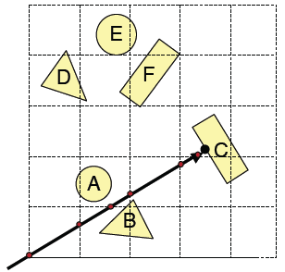
Implementation : Spatial Partitions (2/3)
Trace rays through grid cells
Fast
Incremental
Only check primitives in intersected grid cells

Slide 35
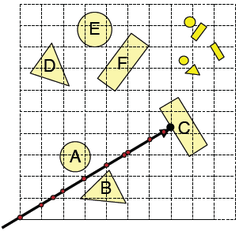
Implementation : Spatial Partitions (3/3)
Implementation issue
How choose suitable grid resolution?
Too little benefit if grid is too coarse.
Too much cost if grid is too fine

Slide 36
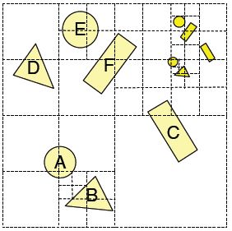
Implementation : Octree
Called as quadtree in 2D
Construct adaptive grid over scene
Recursively subdivide box-shaped cells into 8 octants
Index primitives by overlaps with cells
Generally fewer cells than the uniform grid

Slide 37
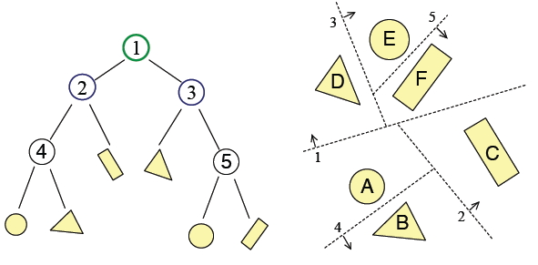
Implementation : Binary Space Partition (BSP) (1/2)
Recursive partition space by planes

Slide 38
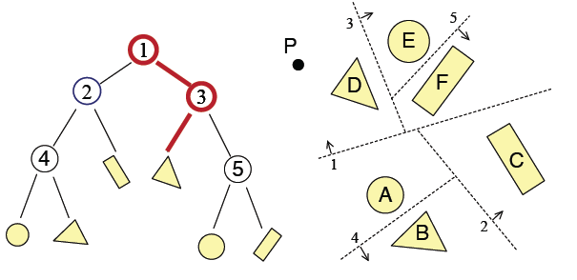
Implementation : Binary Space Partition (BSP) (2/2)
Simple recursive algorithms

Slide 39
Summary
Ray casting
Ray tracing
Recursive ray casting
Inter-object reflection (global illumination)
Highly realistic quality vs. computation time

Slide 40
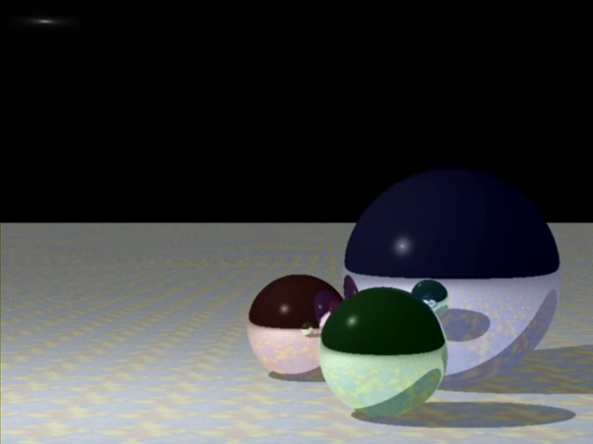
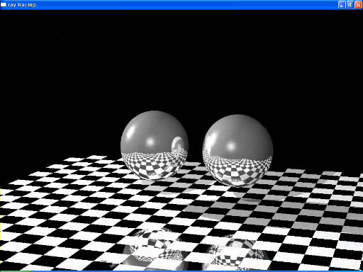
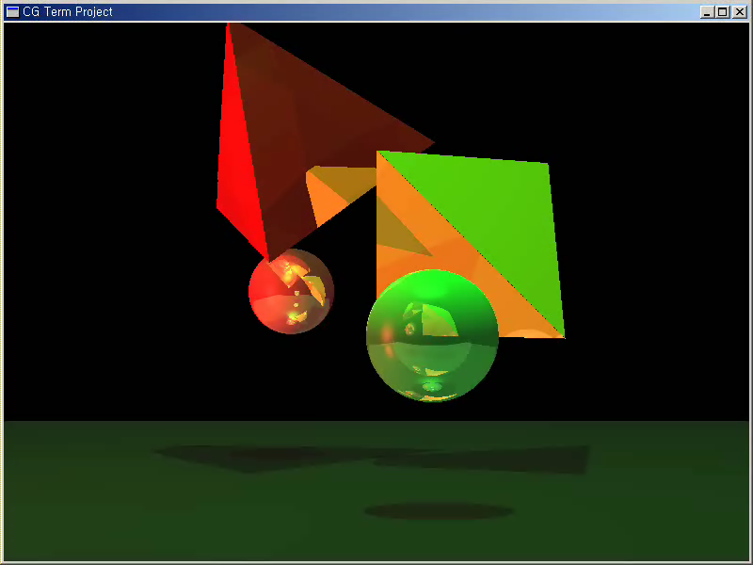
Samples

